Slide 1
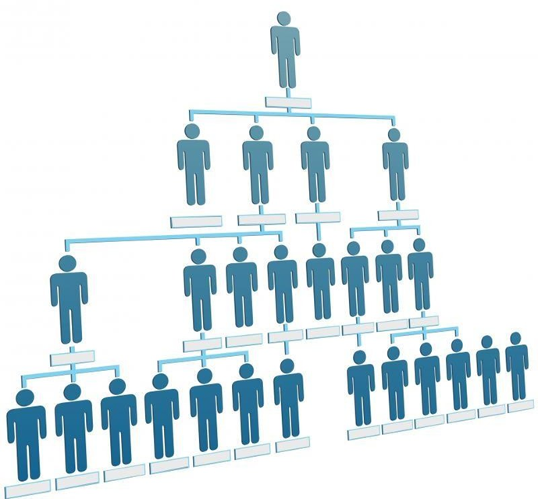
Principles of Management Module 1

Slide 2
Topics (Part 3)
Introduction to Organization
Definition
System approach applied to Organization
Necessity and Elements of Organization
Characteristics of Organization
Process of Organization
Principles of Organization
Formal and Informal Organization
Organization structure
Types of Organization structure

Slide 3
Topics (Part 3)
Introduction to Organization
Definition
System approach applied to Organization
Necessity and Elements of Organization
Characteristics of Organization
Process of Organization
Principles of Organization
Formal and Informal Organization
Organization structure
Types of Organization structure

Slide 4
Introduction to Organization
An organization, or organisation is an entity, such as a company, an institution, or an association, comprising one or more people and having a particular purpose.

Slide 5
Definition
Organization is a pattern of relationships among the individuals working together for a common goal.
It is a system consisting of men, materials, machinery and money working for a common goal.
It is concerned with building, developing and maintaining of effective environment for accomplishing the objectives of the enterprise.
Eg: Banking system

Slide 6
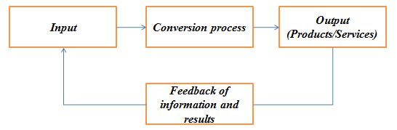
System approach applied to Organization
The systems approach considers organization as a system composed of sub systems that are inter-related.
Systems have boundaries, but they also interact with external environment. That is, they are open systems.
This approach recognizes the importance of studying inter-relationship among planning, organizing, and controlling in an organization as well as the many subsystems.

Slide 7
Necessity of Organization
Complexity of Industry
Growing Competition
Optimum utilization of resources
Fixation of authority and responsibility
Reduced labour problems
Co-ordination and directing efforts
Facilitates administration
Stimulates creativity and inovation.

Slide 8
Essential Elements of good Organization
It must be helpful in the achievement of objectives.
There must be harmonious grouping of activities.
The activities of the organization must be co-ordinated properly.
Proper division of work and labour
An organization should have an effective communication system.
The Span of control should be reasonable.
Provision of expansion and flexibility.
Clear and well defined policies and procedures.
Employees satisfaction is essential
Proper division of authority and responsibility.

Slide 9
Characteristics of Organization
Organization is made up of a group of people.
The group works under an executive head.
It leads to division of work and responsibilities
It defines and fixes the duties and responsibilities of employees.
It establishes a relationship between authority and responsibility and controls the effort of the group
Organization is a step towards achievement of established goals

Slide 10
Process of Organization (Steps in organizing process)
Determination of objectives, strategies, plans and policies.
Determination of activities
Separation and grouping of activities
Delegation of authority
Delegation of responsibility
To establish inter-relationships
Providing physical facilities and proper environment
Preparation of Organisation chart

Slide 11
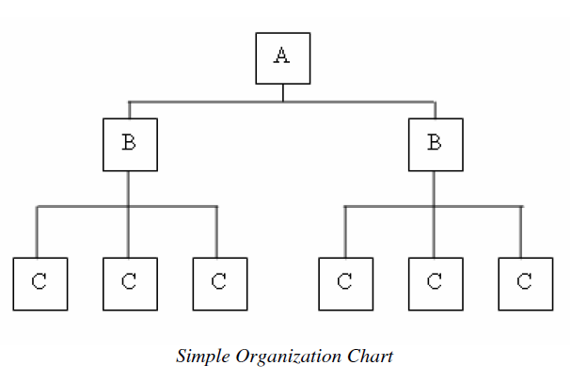
Organization Chart

Slide 12
Principles of Organization
Consideration of unity of objectives: the objectives must be clearly defined for the entire enterprise, for each dept. and even for each position in the organisation structure.
Principle of specialization: Work should be distributed among the persons very carefully on the basis of their skill, experience and ability to do that work.
Principle of authority: Line of authority should be clearly established in the structure of organisation in order to avoid overlapping actions, omission of acts etc.
Principle of Co-ordination: Different depts. should have to co-ordinate with each other to achieve common goals.
Principle of unity of command: Each subordinate should have only one superior and dual subordination should be avoided.
Principle of Span of control: The no. of persons who are directly responsible to the executive is called span of control. In an average firm SOC range is from 6 to 20.

Slide 13
Principles of Organization
Principle of exception: Only exceptionally complex matters should be referred to the executives for their decision and matters of routine nature should be decided by the sub-ordinate themselves.
Principle of flexibility: The organisational structure should be flexible enough to permit slight alterations and expansions whenever needed, due to changed circumstances.
Principle of simplicity: The organisational structure should be simple with minimum no. of levels
Principle of Responsibility: the superior should be held responsible for the acts of his subordinates to whom he has delegated authority.
Principle of balance: There should be balance between;
- the activities
- authority and responsibility
- standardization of procedures and flexibility
- centralization and decentralization

Slide 14
Principles of Organization
Principle of continuity: The Organization structure should be in such a way that it enables to continue its useful existence for a longer period.
Scalar principle: The authority originating from the top should flow below without any interruption.
Principle of parity between authority and responsibility: Authority means ability of the superior to command and responsibility means the obligation of the subordinates to a superior to perform the assigned task. Both should go hand in hand.
Principle of efficiency: Enabling the enterprise to attain objectives with minimum cost and effort.
Principle of Communication: A good communication system is essential for smooth flow of information.

Slide 15
Types of Organization
Formal Organization
FO are those which have a system of well defined positions, authority, responsibility, rules, policies, principles etc.
They are co-ordinated towards a common objectives.
Informal Organization
Arises from the personal and social relations of the people which may or may not be work related.
Arising spontaneously as people associate with one another.

Slide 16
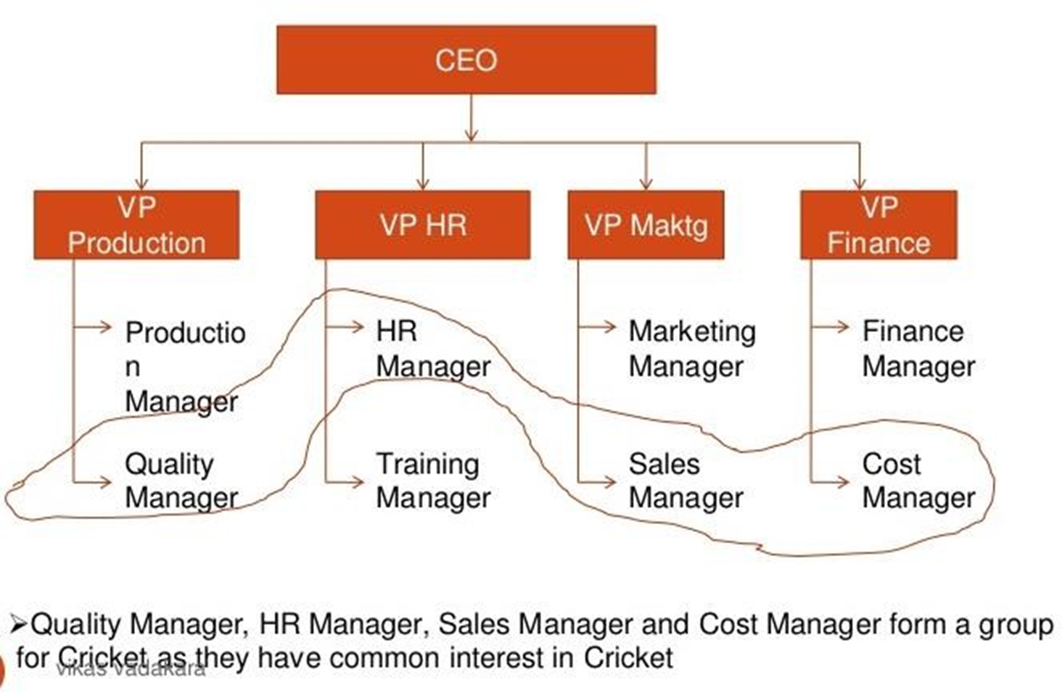

Slide 17
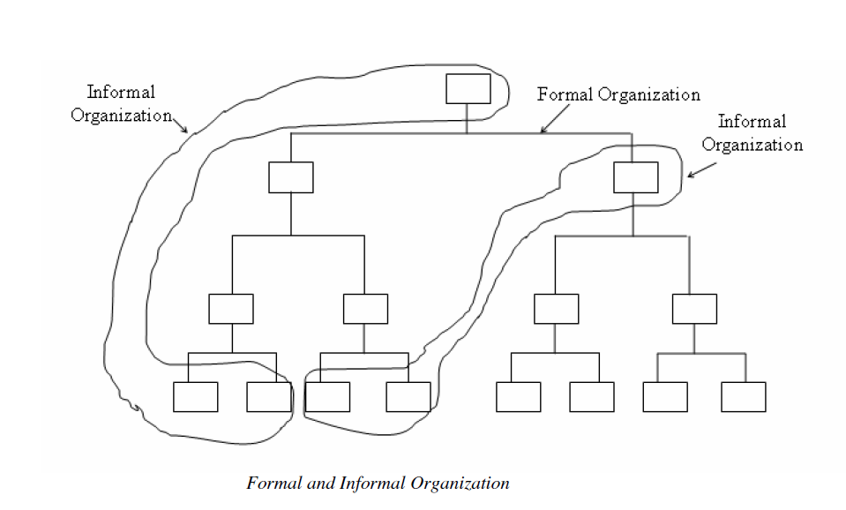
Types of Organization

Slide 18
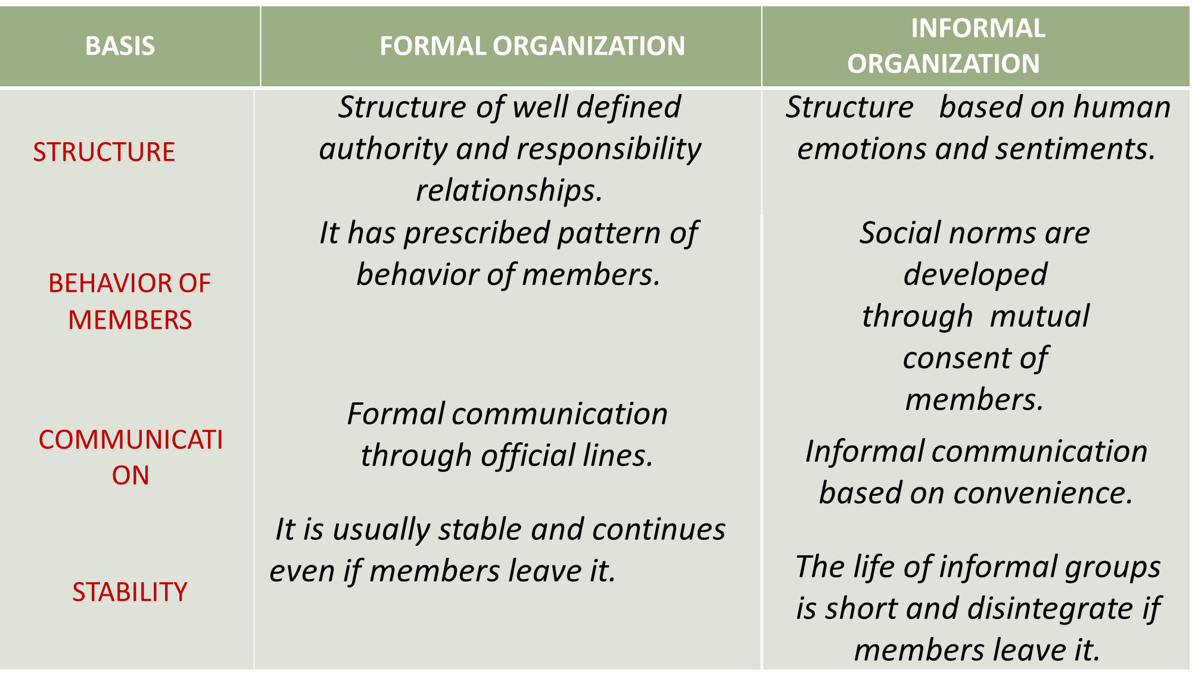
Difference between formal and informal organization

Slide 19
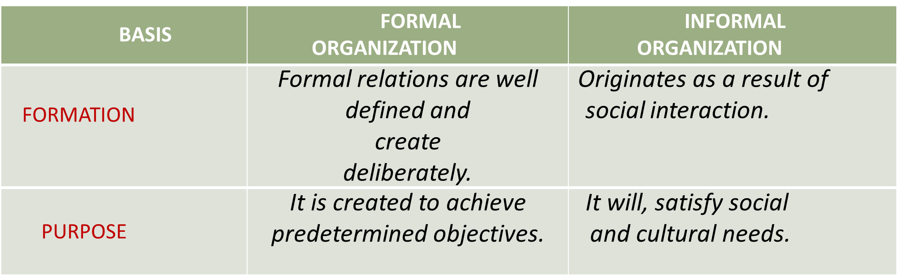
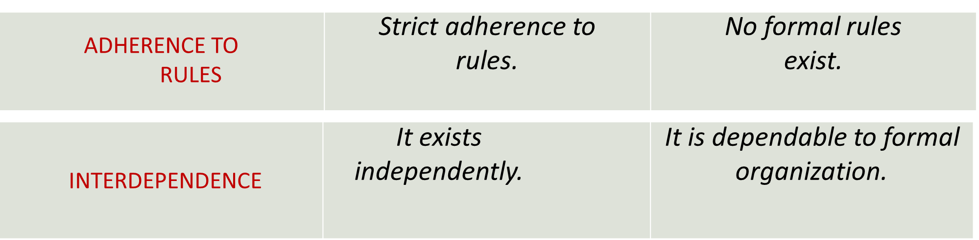

Slide 20
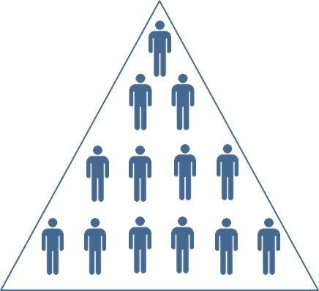
Organization Structure
OS means the systematic arrangement of people working for the organization and their relationship between positions.
It defines the functions to be performed, objectives to be established, the availability of resources, working relationship of the individual participants etc.
Factors
Size of Organization.
Nature of the product being manufactured.
Complexity of problem being faced.

Slide 21
Types of Organization Structure
A few commonly known forms of organization structures or types of organization are:
1) Line organization
2) Line and staff organization
3) Functional Organization
4) Project Organization, and
5) Matrix Organization

Slide 22
Line Organization
Based on similarities of activities, different departments are created.
Each department is placed under one department head & he/she has the full authority all over them.
Authority flows from top to bottom in a vertical line.
Unity of command is maintained.
Superior will be responsible for the performance of sub-ordinate to his commanding officer.
Line Organization is also called military or scalar organization.
Line organization is suitable for small concerns and for automatic and continuous process industries such as paper, sugar, cement, textile, etc.

Slide 23
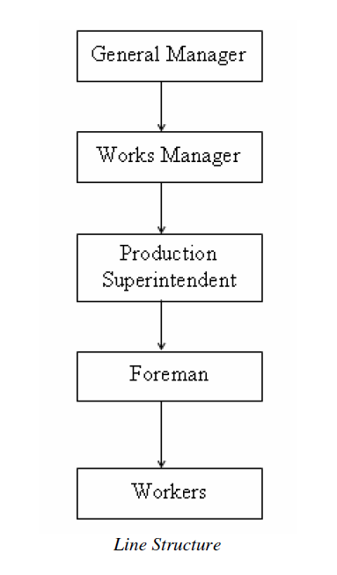
Line Organization

Slide 24
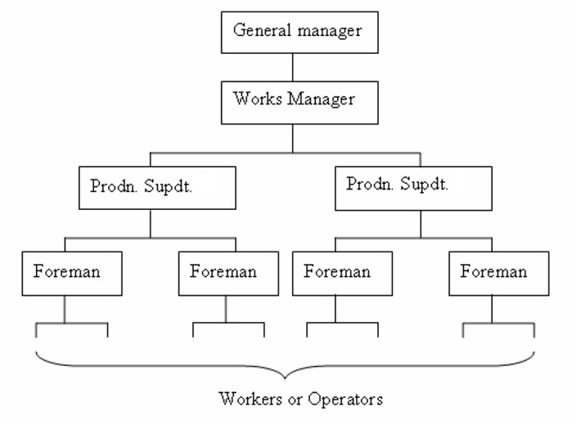
Line Organization

Slide 25
Advantages of Line structure
Simplicity and clarity
Clear cut authority and responsibility
Strong discipline
Capable of developing all round executives at higher levels of authority

Slide 26
Disadvantages of Line structure
Neglects specialists
Lack of specialization may lead to wastage of materials as well as man and machine hours
Overloads a few important executives
Encourages dictatorial way of working
Limited to very small concerns

Slide 27
Line and staff organization
In a big organization manager will have to do a variety of functions and he may not be expertise in all areas.
Special executives will be employed to assist line executives and they were known as staff, whom to perform specialized function.
Supervisory authority will be given for line executives and the staff executives gives advices and expert opinion, have no direct authority.

Slide 28
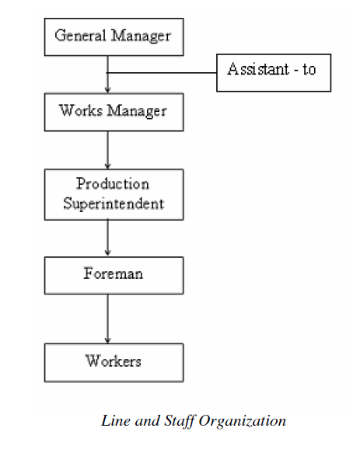
Line and staff organization

Slide 29
Advantages of Line and staff organization
Specialization benefits of staff can be profitably utilized to have standard operations.
Line executives are relieved of some of their workloads and are thus able to concentrate on other important matters.
Less wastage of material and labour
Improved product quality
Relatively flexible

Slide 30
Disadvantages of Line and staff organization
Staff – line conflict
Paper work may be increased very much
Staff men may dominate over the lower the lower-level line managers
Increased product cost because of high salaries of staff executives
Too much staff activity may complicate a line executive’s job of leadership and control

Slide 31
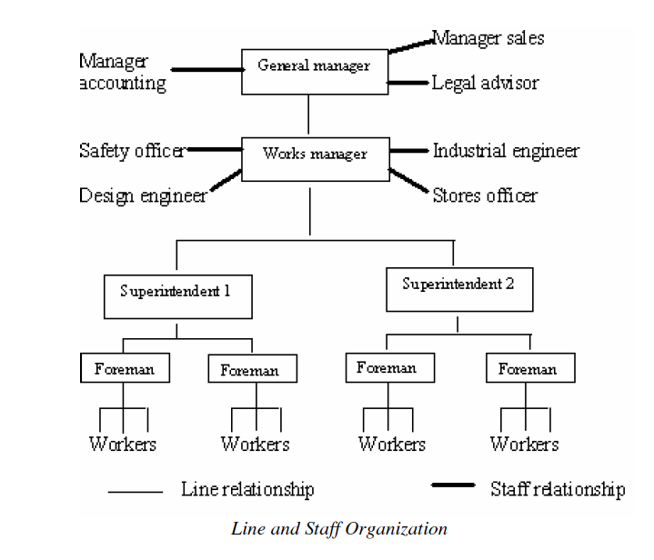
Line and staff organization

Slide 32
Functional organization
Modified form of line organization
Authority rests with functional heads
Staffs are grouped and located by specialty into functional departments: each headed by a functional manager. Each member of staff has one clear boss.
Functional manager are specialists in their respective areas and is based on high degree of specialization.
This specialization leads to greater efficiency and refinement of particular expertise.
The functional structure helps to focus on those departments that are critical for the success of the enterprise.

Slide 33
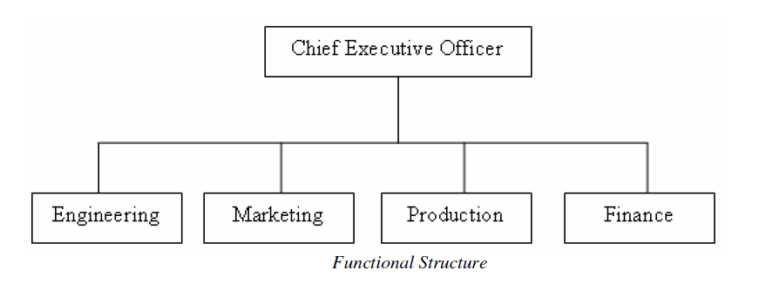
Functional organization

Slide 34
Advantages of Functional organization
Efficient use of resources
Simplifies training
Promotes professional development
Centralized control of strategic decisions
Improved quality of work

Slide 35
Disadvantages of Functional organization
Limits development of general managers or all-round executives
Restricted view of company objectives
Difficulty in multifunctional decision making
Promotes narrow specialization
Makes industrial relationships more complex

Slide 36
Project Organization
Firms dealing with multiple products or different projects usually adopt project organization.
It consist of an autonomous project team, existing independently of the rest of organization.
The emphasis in project organization is on creation of teams for the accomplishment of specific objectives.
The project team is assembled for a specific project under the action of project manager.
The team is thus temporary and will be dispersed when the project is completed.

Slide 37
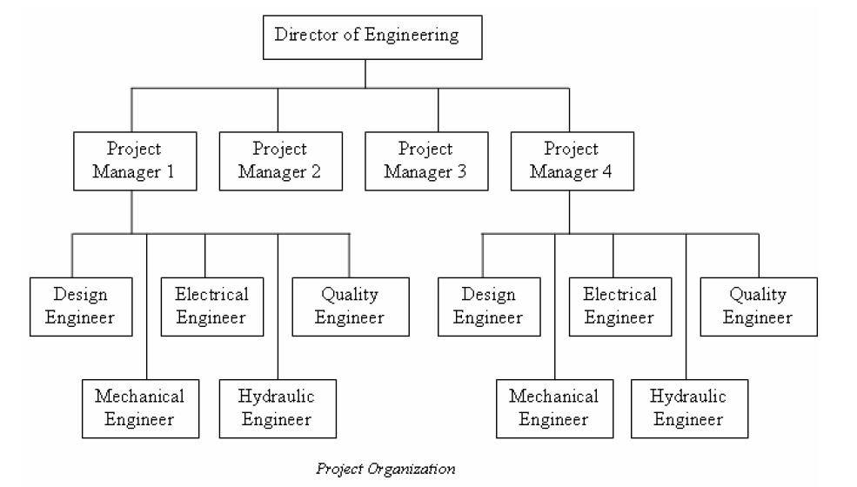
Project Organization

Slide 38
Advantages of Project Organization
Flexibility
Responsive to changing environment
Encourages team work

Slide 39
Disadvantages of Project Organization
Projects can be of short duration leading to frequent change in organization structure
Professionals prefer to be allied with their professional group rather than being allied with a project
Trained professionals need not tolerate the insecurity of frequent organization change

Slide 40
Matrix Organization
They are those that comes between fully functional and fully project organizational structure.
Staffs are grouped and located by speciality into functional units headed by a functional manager.
The project manager works with the functional manager for timely completion of project.
The matrix organization is an organization structure that establishes two chains of command, one vertical and one horizontal, at the same time.
It is intended to combine the advantages of functional structure and project structure.

Slide 41
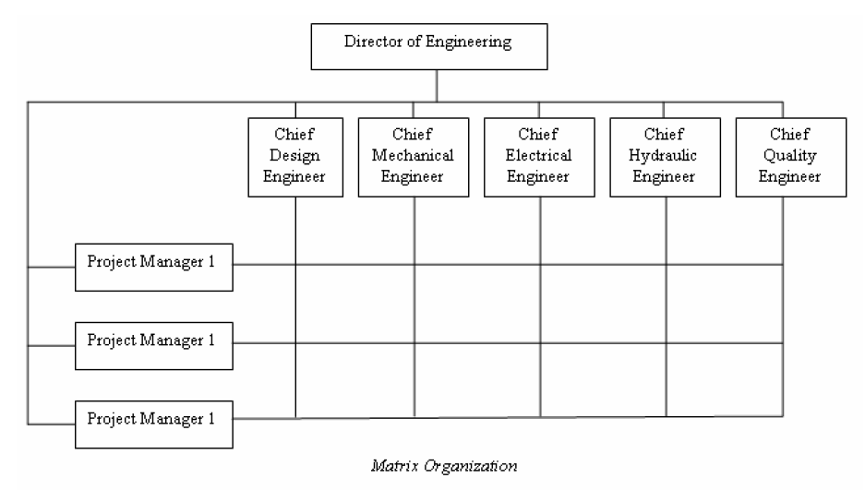
Matrix Organization

Slide 42
Advantages of Matrix Organization
Decentralized decision making
Efficient use of functional managers
Capable of adapting to fast environmental changes
Flexibility

Slide 43
Disadvantages of Matrix Organization
Violates the principle of unity of command
High administrative costs
Requires tremendous horizontal and vertical co-ordination
Chances of interpersonal conflicts

